Slide 1
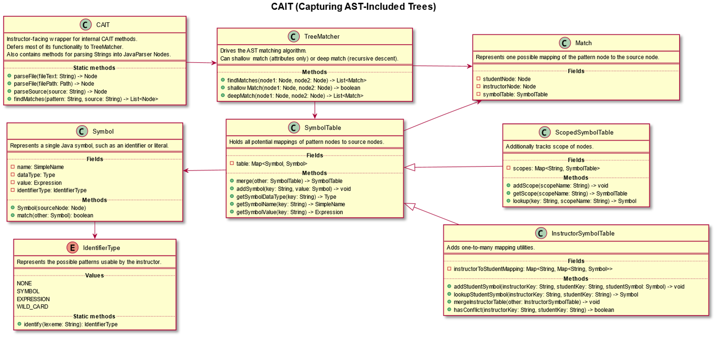


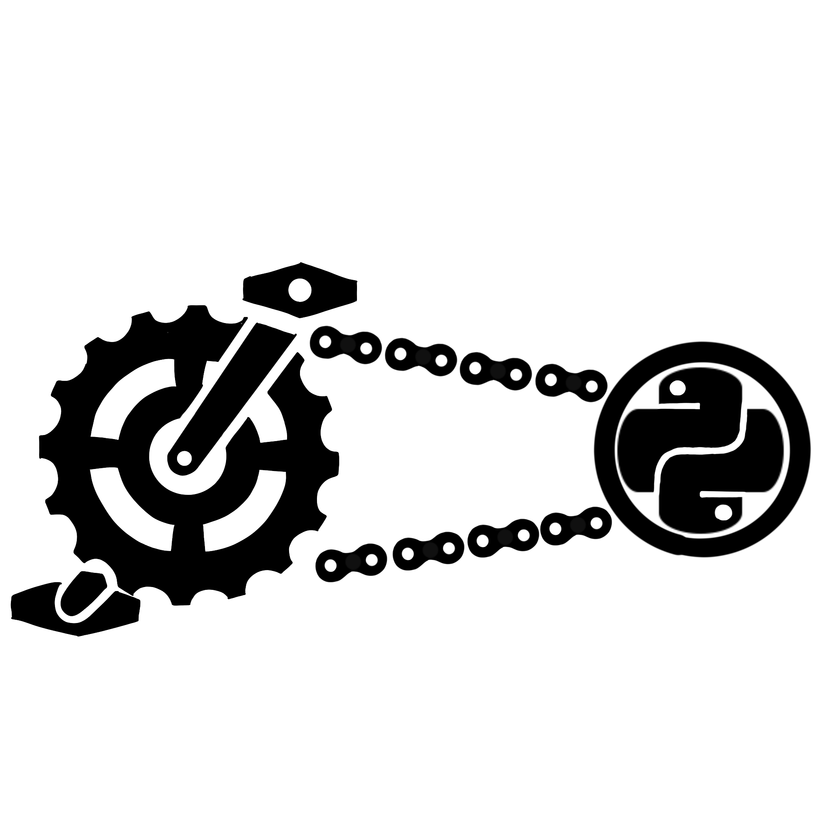

25-312
Java Pedagogical Libraries for Code Analysis
Team members: Derek Chiou, Luca Doutt, Ghulam Mujtaba Qasimi, Kennedy Westry | Faculty adviser: Luke Gusukuma, Ph.D. | Sponsor: VCU College of Engineering | Mentor: Luke Gusukuma, Ph.D.
Problem
Background
Solution
Manual grading for code submissions is time-consuming and not scalable for large classes
Current automated feedback systems detect surface-level syntax errors or match outputs using unit tests
Compiler errors, by themselves, are unhelpful for beginners
Pedal (Pedagogical Library) by Luke Gusukuma and Austin Bart, an instructor-centric framework for automated code feedback
Written in Python, works on Python files
Many introductory courses instead use Java, motivated by object-oriented foundations
Create JPedal, the Java version of Pedal
Implement the CAIT (Capturing AST-Included Trees) module, allowing the instructor to declaratively check for certain patterns in student code
Lay the groundwork for the remaining modules
Builds with Gradle and IntelliJ

